Slide 1

Bank Loan Analysis
Uncovering insights from 38,576 loan applications to improve lending decisions and reduce credit risk through data-driven analysis.

Slide 2

PROJECT GOALS
Analysis Objectives
Customer Behavior
Approval Factors
Analyze characteristics and patterns of loan applicants
Identify key drivers influencing loan approval decisions
Default Risk
Policy Insights
Understand borrower behavior and credit risk indicators
Generate actionable recommendations for risk assessment

Slide 3

Technology Stack
Python
Core language for data analysis and preprocessing
Pandas & NumPy
Data manipulation and numerical computing
Matplotlib & Seaborn
Advanced data visualization libraries
Jupyter Notebook provided the interactive environment for analysis, while Excel supported initial data inspection.

Slide 4
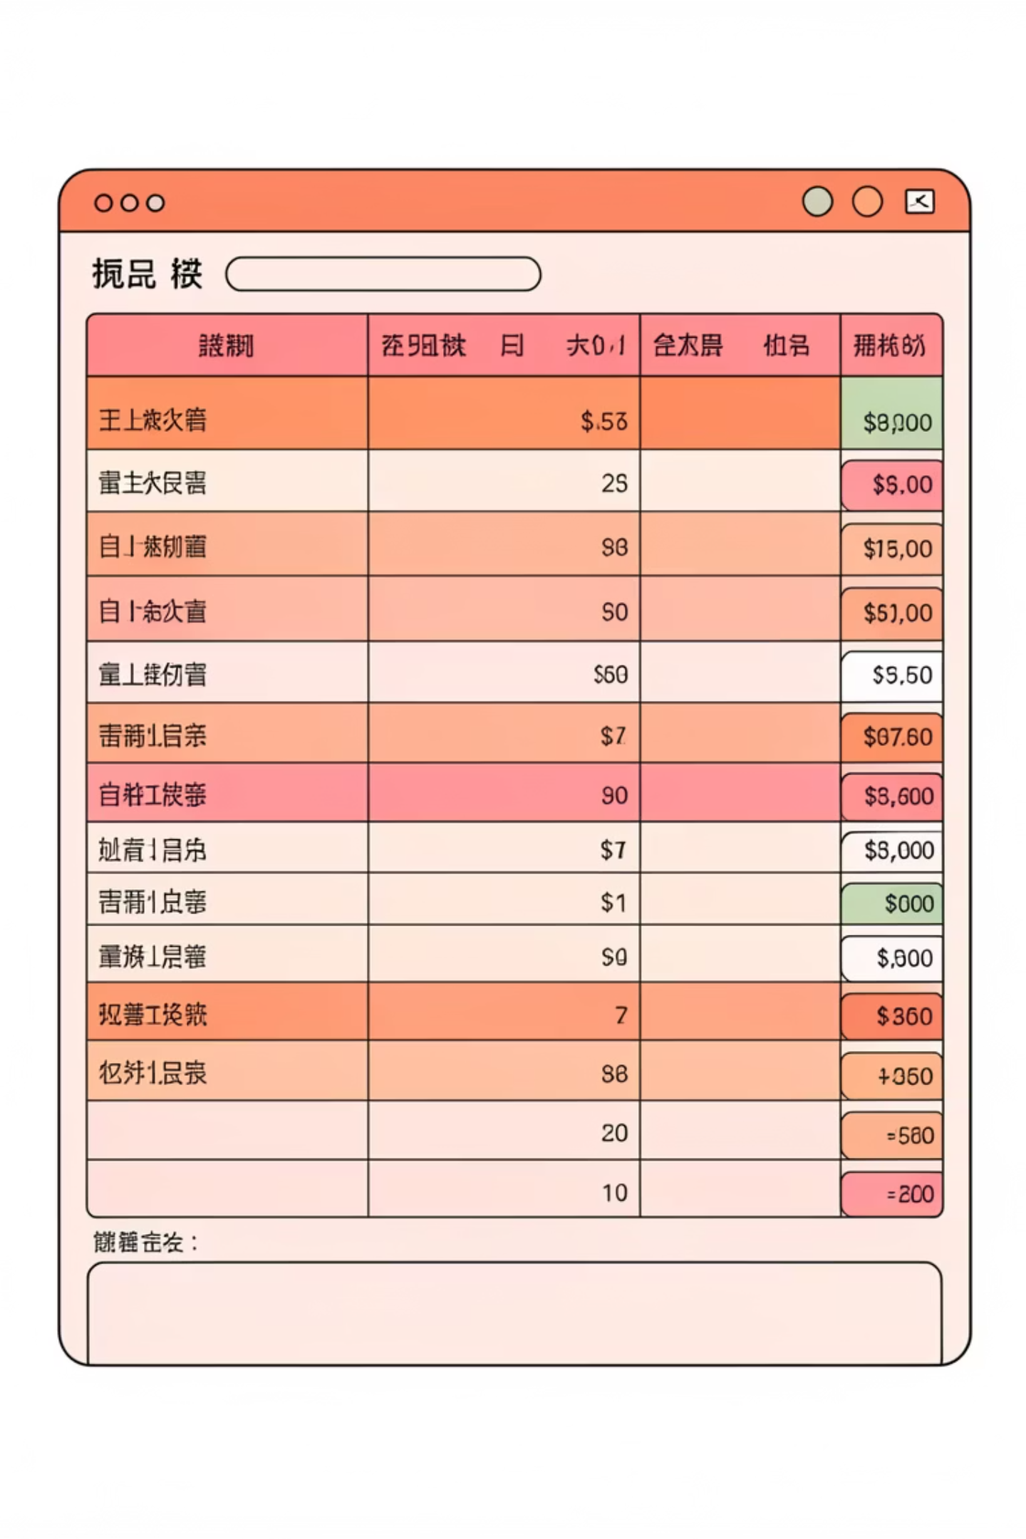
Dataset Overview
38,576
24
3
Total Records
Data Attributes
Key Categories
Comprehensive loan applications analyzed
Columns covering applicant and loan details
Applicant info, loan details, credit data
Dataset includes applicant information (age, employment, income), loan details (amount, term, interest rate), and credit information (history, debt-to-income ratio, loan status).

Slide 5
DATA PREPARATION
Cleaning & Preprocessing
01
02
03
Data Structure Review
Missing Values
Duplicate Removal
Checked data types and structure using .info() method
Identified and handled missing data appropriately
Eliminated duplicate records to ensure data quality
04
05
Standardization
Validation
Normalized column names and categorical variables
Verified consistency and identified outliers

Slide 6

Exploratory Data Analysis
Key Analyses Performed
Visualization Methods
Distribution of loan amounts across customers
Bar charts for status distribution
Income vs loan approval trends
Histograms for income patterns
Loan status comparison by employment type
Pie charts for approval ratios
Credit history impact on approval rates
Correlation heatmaps
Default rate analysis by loan amount and income

Slide 7

CRITICAL FINDINGS
Key Insights Discovered
Income & Credit Impact
Default Risk Patterns
Applicants with higher income and strong credit history show significantly higher approval rates
Loan defaults are more common in cases with higher loan-to-income ratios
Loan Term Behavior
Employment Stability
Shorter loan terms demonstrate better repayment behavior and lower default rates
Job stability significantly impacts loan approval decisions and repayment success

Slide 8

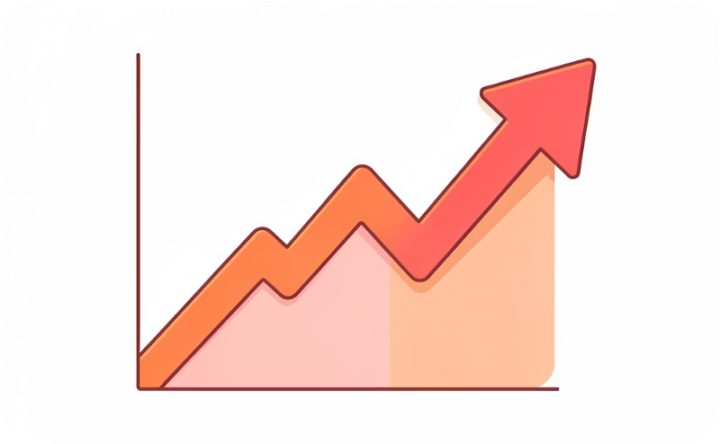
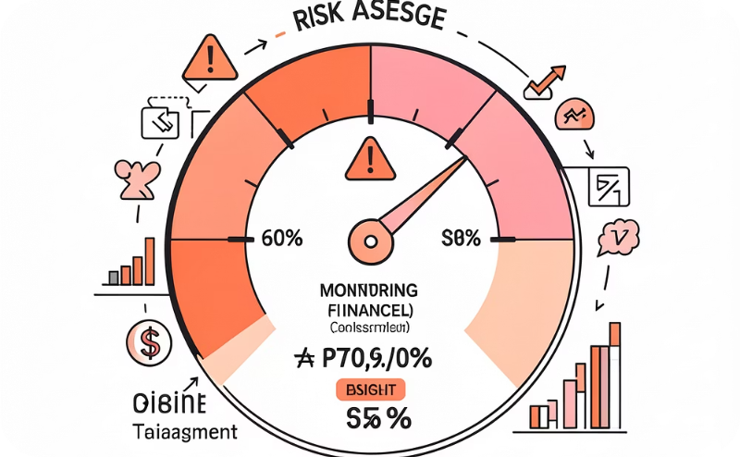

Business Impact
Improve Approval Policies
Reduce NPAs
Early Risk Detection
Optimize Interest Rates
Lower non-performing assets through risk identification
Identify high-risk applicants before approval
Data-driven criteria for better lending decisions
Risk-based pricing for better profitability

Slide 9





ACTION ITEMS
Strategic Recommendations
Strengthen Credit Checks
Enhanced verification for high loan amounts to minimize default risk
Risk-Based Interest Rates
Implement dynamic pricing models based on borrower risk profiles
Monitor High-Risk Borrowers
Close tracking of applicants with high debt-to-income ratios
Encourage Shorter Terms
Promote shorter loan tenures where feasible for better repayment
Data-Driven Scoring
Deploy automated scoring models for consistent approval decisions

Slide 10


Conclusion
Data analytics transforms lending decisions by reducing risk, increasing profitability, and enhancing customer trust.
This Bank Loan Analysis project demonstrates the practical power of Python-based analytics in the financial domain. By examining borrower profiles, loan characteristics, and repayment behavior, banks can make smarter decisions that benefit both the institution and its customers.
Key Takeaway: The combination of thorough data cleaning, exploratory analysis, and actionable insights creates a framework for sustainable lending practices and improved risk management.

